Slide 1


Slide 2
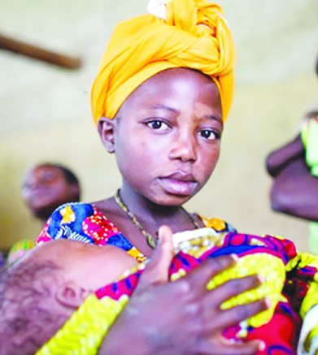
Problem
31% Below 18
5% of Girls
777K Births
Notes:
Every year, an estimated 21 million girls aged 15–19 years in developing regions become pregnant and approximately 12 million of them give birth. At least 777,000 births occur to adolescent girls younger than 15 years in developing countries according to WHO. Other population of youth may end up in issues such as lack of discipline, antisocial behaviour, missing school, underage drinking, drug abuse, e.t.c. According to UNICEF, 5% of Girls in Tanzania get married before 15 and 31% before 18. Main reason is that most youths haven’t identified any of their own aims or targets to work towards which leads them to fall in disappointing destinations.
31% of girls in Tanzania are married before their 18th birthday and 5% are married before the age of 15

Slide 3

Market
900M
45M
Total Market Size
Target Market
Notes:
31% of girls in Tanzania are married before their 18th birthday and 5% are married before the age of 15 UNFPA (United Nations Population Fund)

Slide 4

The Solution
Creating a digital platform that will connect all youths around the world to share the challenges and experiences they face in life and get life guidance from experts of different fields.

Slide 5

Business Model
Advertisements
Selling Data

Slide 6

Why Crystal?
Technology has led to easy access of information to anyone even the immoral information.

Slide 7



How it works
Step 3
Step 2
Step 1
Learn, share and experience with others
Register your personal details
Open your web browser then go to www.crystal-tz.web.app

Slide 8
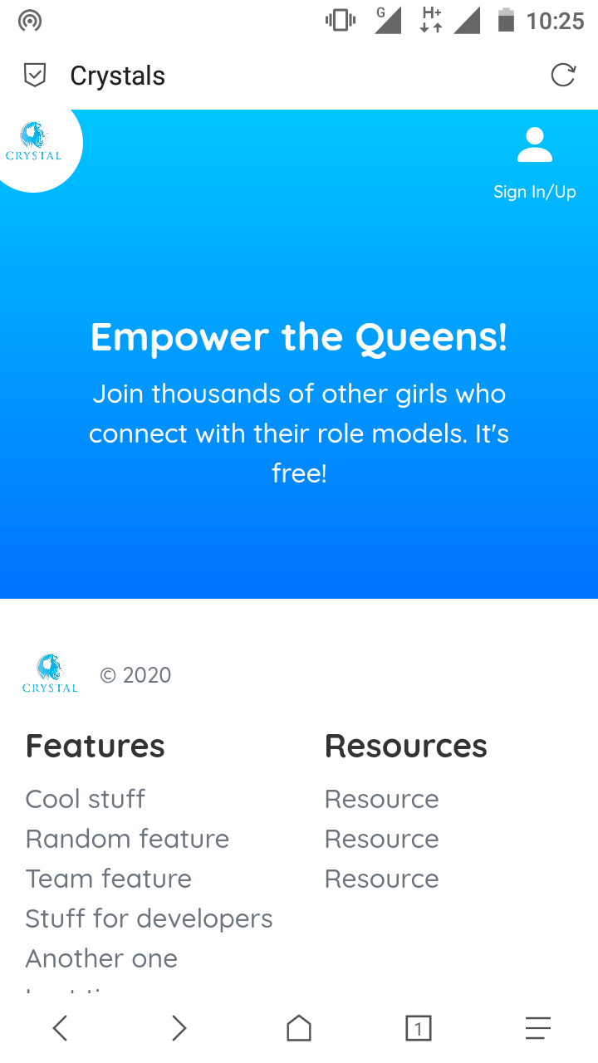

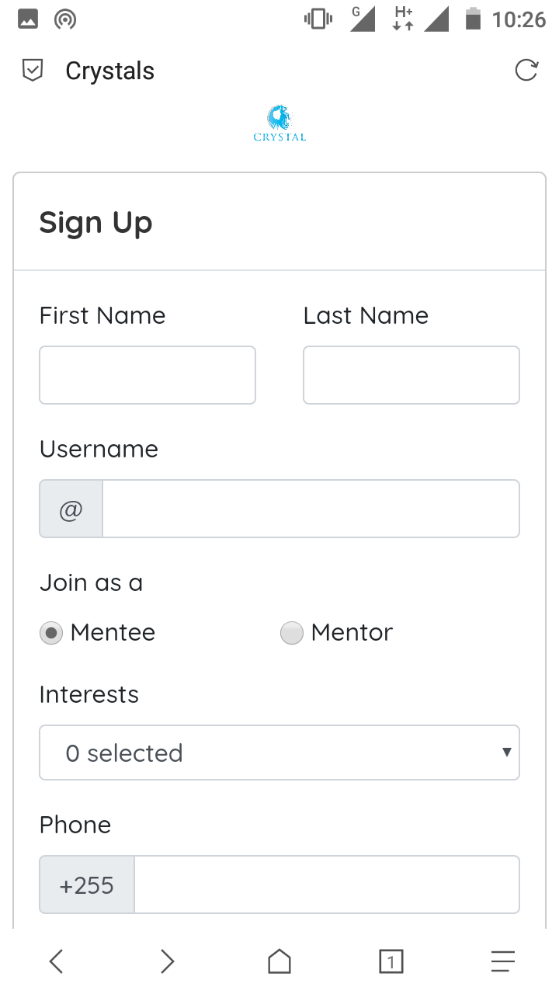
Product

Slide 9
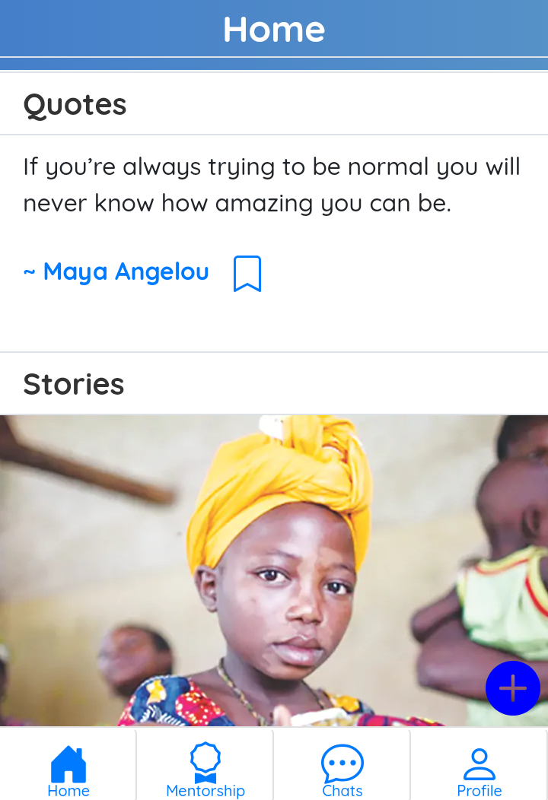

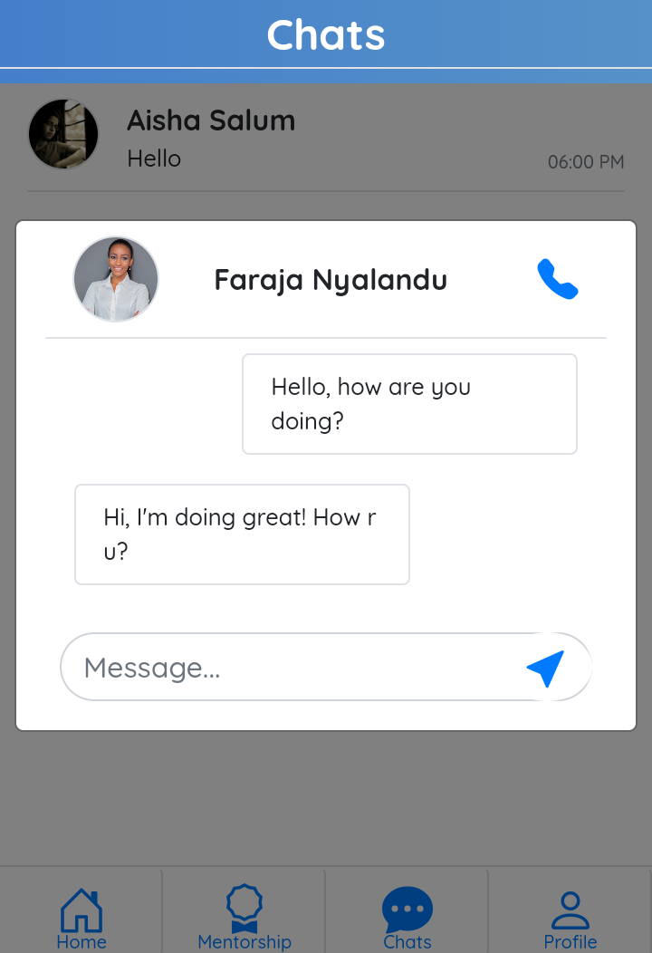
Product

Slide 10
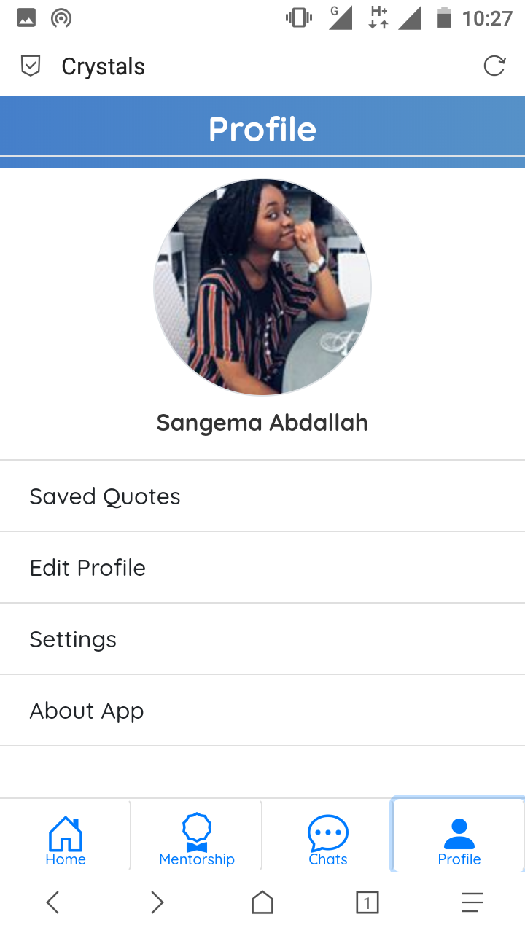
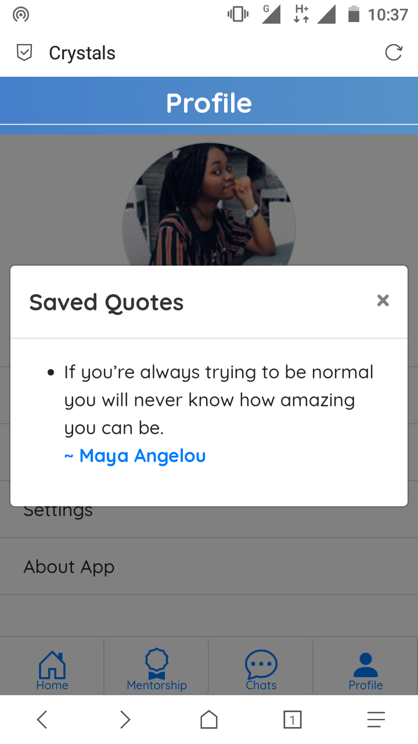
Product

Slide 11





The Team
Christine Mlay
Queen Erasto
Mercy Mujuni
Leyla Ramadhan
Sangema Abdallah
Victoria Simon
Adelphine Francis

Slide 12
Milestones
Market Research
Fundraising
Marketing
Partnerships
Launching

Slide 13
Empower the Queens

